Slide 1
Kaggle – U.S. Patent Phrase to Phrase Matching
K
組長 : 吳逸邦
組員 : 黃振嘉 楊智翔 許紘碩

Slide 2
Data 說明
K

Slide 3
Anchor vs target
Unrelated
Very close match
0
0.25
0.5
0.75
1

Slide 4


Slide 5
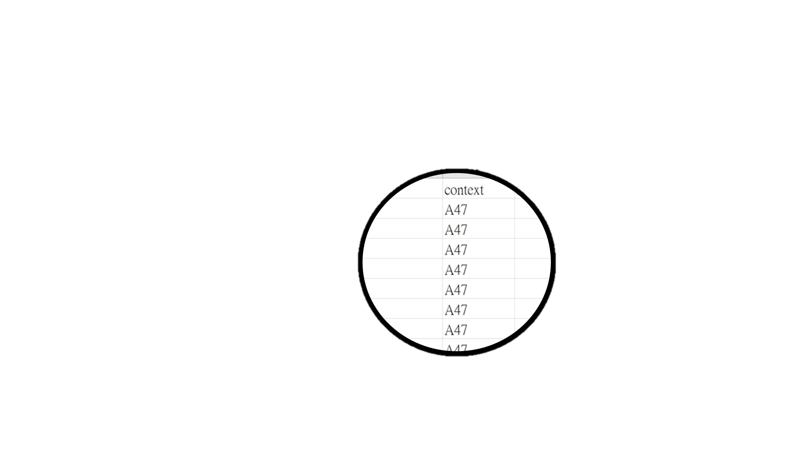
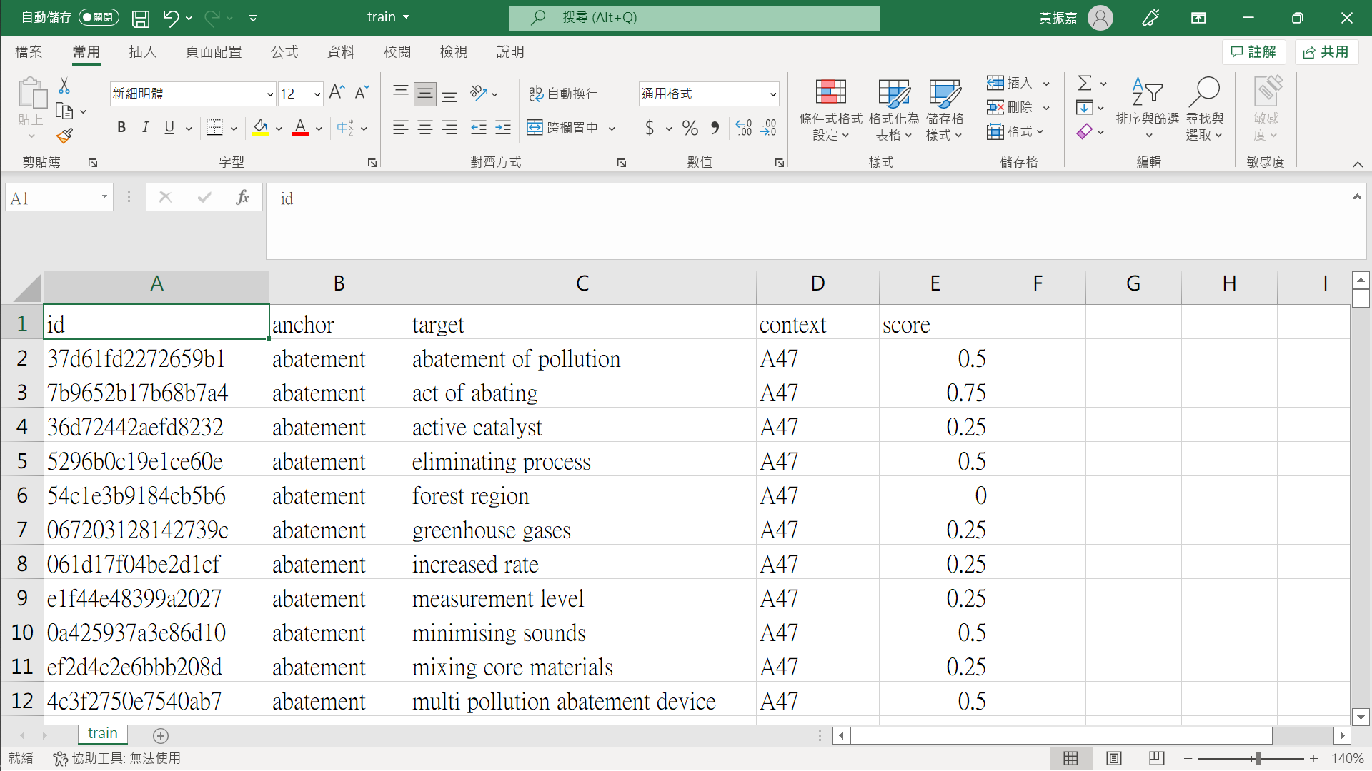

Context 代碼
A: Human Necessities
B: Operations and Transport
C: Chemistry and Metallurgy
D: Textiles
E: Fixed Constructions
F: Mechanical Engineering
G: Physics
H: Electricity
Y: Emerging Cross-Sectional Technologies
Notes:
Cooperative Patent Classification
A: Human Necessities
B: Operations and Transport
C: Chemistry and Metallurgy
D: Textiles
E: Fixed Constructions
F: Mechanical Engineering
G: Physics
H: Electricity
Y: Emerging Cross-Sectional Technologies
This is followed by a two-digit number to give a "class symbol" ("A01" represents "Agriculture; forestry; animal husbandry; trapping; fishing"). The final letter makes up the "subclass" (A01B represents "Soil working in agriculture or forestry, parts, details, or accessories of agricultural machines or implements, in general"). The subclass is then followed by a 1- to 3-digit "group" number, an oblique stroke and a number of at least two digits representing a "main group" ("00") or "subgroup".

Slide 6
觀察與發現
K

Slide 7
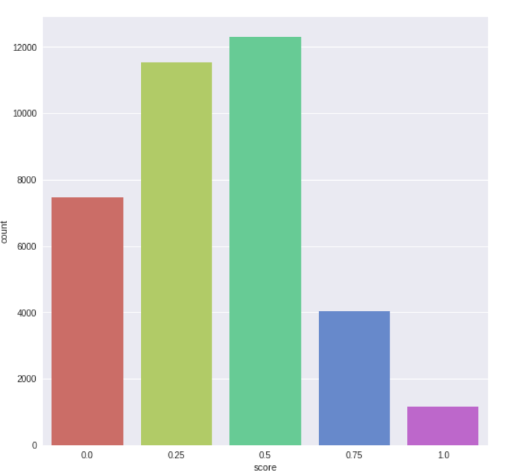
Notes:
各個score的長條圖
橫軸: score
縱軸: 數量
觀察:1.0 和 0.75的較少(特別是score = 1.0 的)
這之後要解決 利用增加資料量或者調整權重

Slide 8
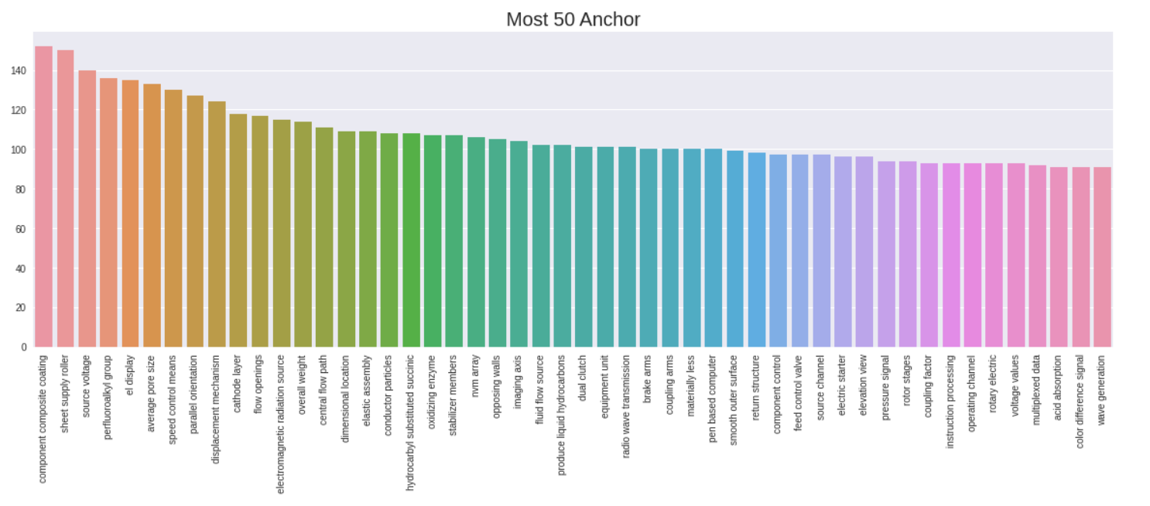
Notes:
前50多種的anchor的barplot
橫軸: anchor
縱軸: 數量
觀察: 前50多的大多落在100到100多之間

Slide 9
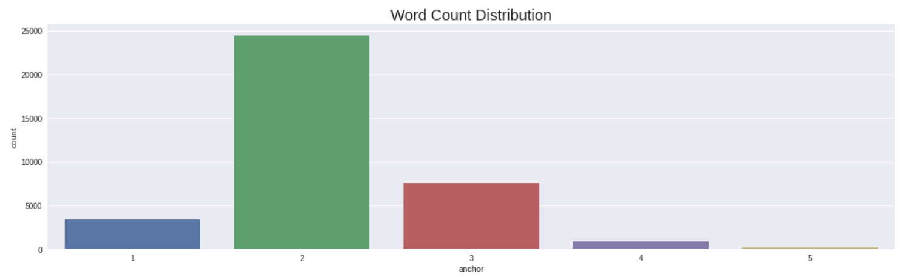
Notes:
Anchor的字數長條圖
觀察: 兩個字的比例最多

Slide 10
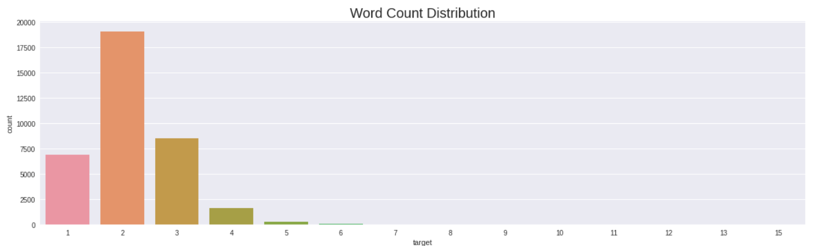
Notes:
Target 比較長有到15個字的

Slide 11
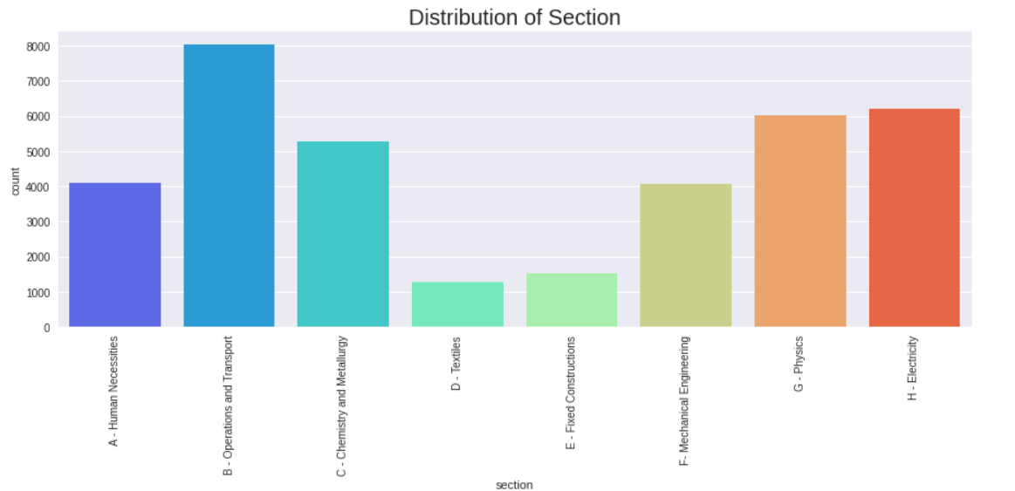
Notes:
Context的Section分類

Slide 12
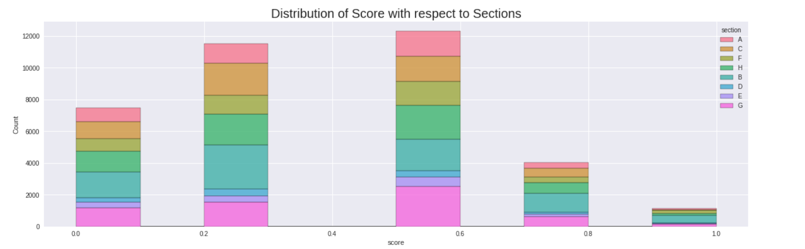
Notes:
不同section在各個Score的裡面的比例

Slide 13
目前進度
K

Slide 14
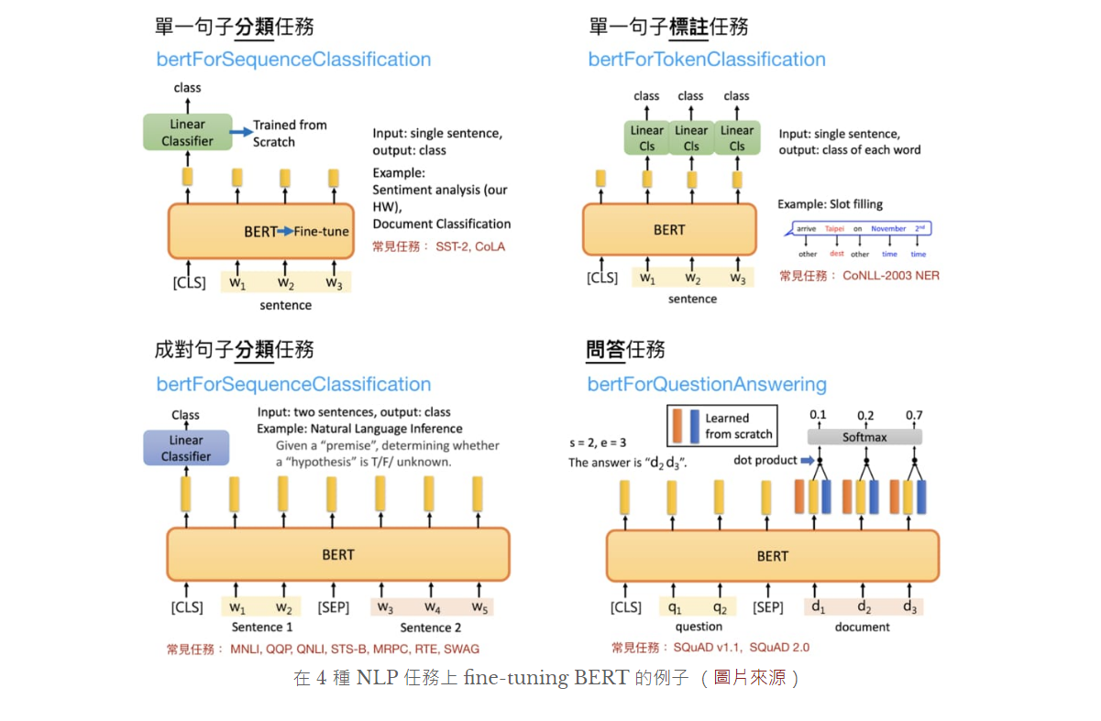
Notes:
基於變換器的雙向編碼器表示技術 英語：Bidirectional Encoder Representations from Transformers
Model : Bert base cased(pre-trained)
Fine-tuned : BertForSequenceClassification
Sequential layer + activation function

Slide 15
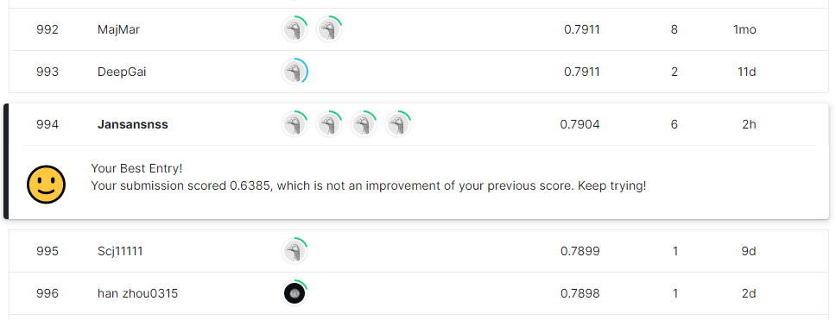

Slide 16
未來方向
K

Slide 17
前處理再多一些詞性處理
多嘗試各種模型也持續調整參數

